Slide 1





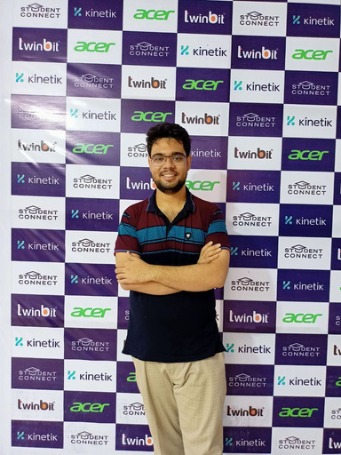





Team Veni Vidi Vici
Presents GreenBlox - Revolutionizing Carbon Offsetting with Blockchain Transparency
Zia Ul Hassan Abdullah
Mst. Fahmida Sultana Naznin
Swarup Sidhartho Mondol
Prithu Anan
Adila Ahsan
Management Studies,
BUP
CSE, BUET
CSE, BUET
CSE, BUET
CSE, BUET

Slide 2




SituationAnalysis
CO2
Bangladesh
Industrial Emissions and Climate Impact in
CURRENT CHALLENGES
Industrial CO2 Emissions
Economic Impact of Climate Change
Financial Losses
100
(2024)
Decrease
Total annual carbon emissions: million tonnes
Crop Yield
Average cost of tropical cyclones: $1 billion annually
Projected crop production drop: 30% by 2100
Textile
mills
RMG
industry
Potential GDP loss due to severe flooding: up to 9%
Rice production: 8.8% reduction by 2050
Agricultural GDP loss by 2050: one-third
Steel factories
Major
Contributors
Wheat production: 32% reduction by 2050
Brick
kilns
Internal climate migrants by 2050: 13 million people
Cement plants

Slide 3

SituationAnalysis
SECTOR-WISE CO2 EMISSIONS
Energy Sector
Steel Factories
Largest contributor: Electricity sector (34%)
CO2 emissions: 10 million metric tonnes
RMG Sector
Cement Plants
Greenhouse gas emissions: 15.4%
CO2 emissions: 7 million metric tonnes
Textile Sector
Greenhouse gas emissions: 12.4%
Brick Kilns
Annual emissions: 15 million metric tons
CO2 emissions: 20-23 million tonnes
Additional pollutants in Dhaka: SO2, CO, PM2.5, BC

Slide 4



SituationAnalysis
Bangladesh's Carbon Credit and Offset Initiative
Balancing Economic Growth with Environmental Sustainability
CURRENT SITUATION
Carbon Credit Initiatives (since 2006)
Sectoral Contributions
Projects: Improved cook stoves, solar home systems (managed by Idcol)
Revenue: $16.25 million
Textile sector
Ready-Made Garment (RMG) industry
Earned substantial revenue from carbon credits
Generated: 2.53 million carbon credits
Showcases initial success in carbon trading
Brick
kilns
Key
Sectors
Cement
plants
Government Initiatives
Steel factories
Renewable Energy Target
Key
Projects
Commitment
Impacts
Pivotal role in Bangladesh's emissions profile
Necessitate rigorous emission reduction measures
Increase renewable energy share to 10% of total electricity generation by 2030
Promotion of solar power
Solar irrigation
Waste-to-energy projects
Sustainable development

Slide 5



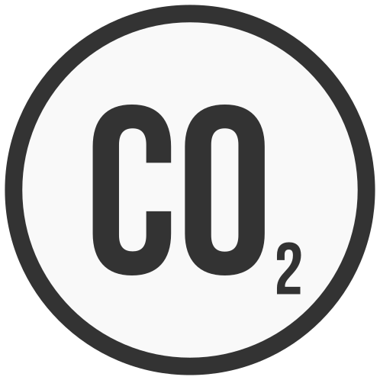

Verification
Failures
Mismanagement Issues
Key Points for Carbon Offset Failure
Inadequate monitoring
Poor verification processes
the credibility of carbon reductions
Poor project planning
Ineffective execution
Leads to ineffective outcomes
Lack of Transparency
Untraced Carbon Credit Flow
Funding
Challenges
Insufficient disclosure
Poor reporting on project impacts
Undermines trust in offsetting initiatives
Poor tracking from production to retirement
Difficulty in verifying credit usage
Reduces effectiveness of offset programs
Renewable and sustainable projects
Difficulty in securing proper funding
Limits project development and implementation

Slide 6



Solution
BIG IDEA
GreenBlox: Revolutionizing Carbon Offsetting with Blockchain Transparency
Goals
Verification
Transparency
Carbon Reduction
Achieving 100% Verification by 2030
Auto-Trackable Carbon Credit Transaction
10% Carbon Reduction within 2030

Slide 7
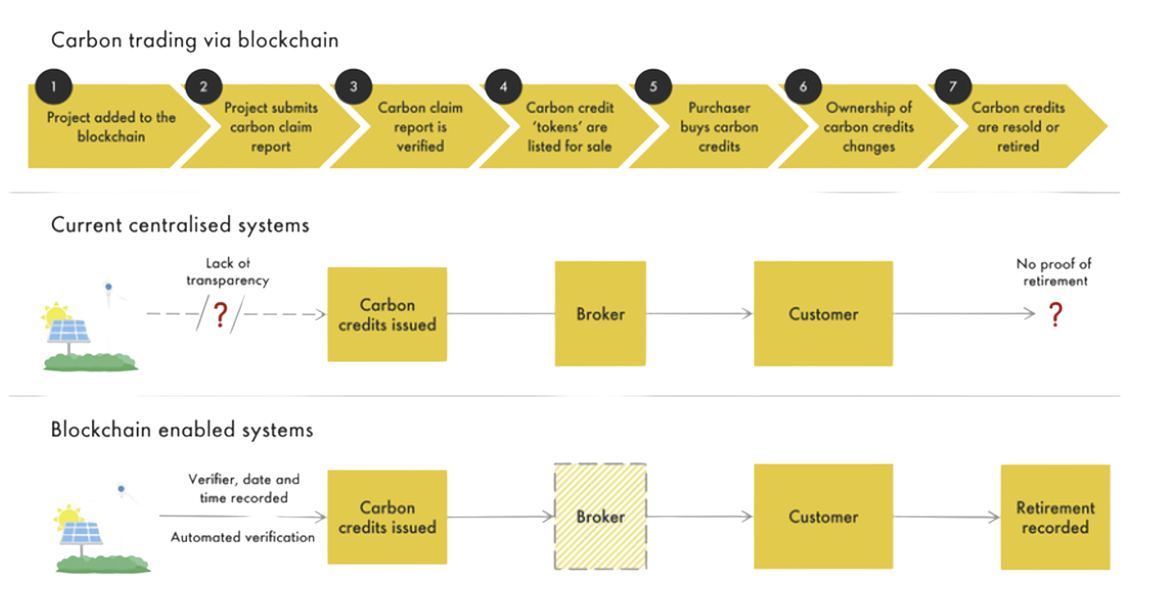
Key Differences: Standard vs. GreenBlox

Slide 8
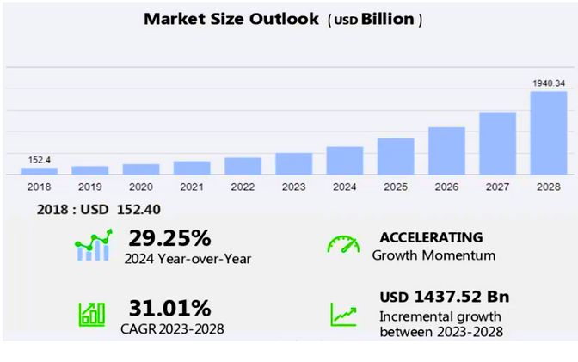
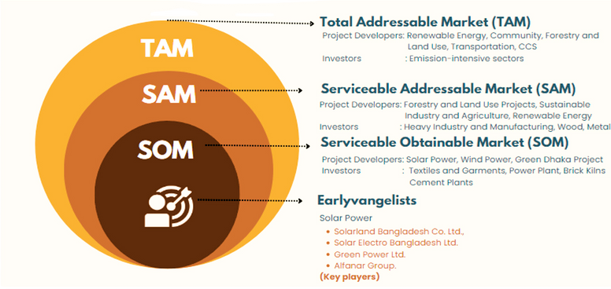
MARKET PROJECTION
Target Market
The current market size of the carbon offset/carbon credit market is 331.8 billion in 2022
Global Market Size
Carbon Credit Market Analysis 2024-2028
Largest Segment
Key Segments
End-User : Power segment
Market Size : Increase by USD 1,437.52 billion
CAGR : 31.01% (2023-2028)
Study Period : 2024-2028
Historic Period : 2018-2022
End-User : Power, Energy, Transportation, Industrial, Others
Type : Compliance, Voluntary
Regions : North America, Europe, APAC, South America, Middle East & Africa
Fastest Growing Region
Region : Europe (85% growth)
Market Dynamics
Key Driver : Adoption of net-zero targets
Key Trend : Demand for standardized assessment
Key Challenge: Insufficient governance
Local Market Size (Bangladesh)
CO2 Reduction Goal : 22% by 2030
Current annual emissions : 100 million tonnes
Revenue from carbon credits: $16.25 million from 2.53 million credits since 2006

Slide 9





Partners
Payment Gateways
Service Operators
Regulators
Bangladesh Bank
Bangladesh Power Development Board (BPDB)
Department of Environment (DoE)
Ensure secure financial transactions and compliance with regulatory standards
Ensure environmental regulations are met and oversee carbon offset projects
Oversee renewable energy projects and infrastructure
Local Fintech Companies
Infrastructure Development Company Limited (IDCOL)
Ministry of Environment, Forest and Climate Change (MoEFCC)
Facilitate seamless payment processing for carbon credit transactions
Implement and manage carbon credit projects, including solar home systems and improved cook stoves
Formulate policies and provide regulatory oversight
Waste Concern
Manage waste-to-energy projects and composting initiatives

Slide 10
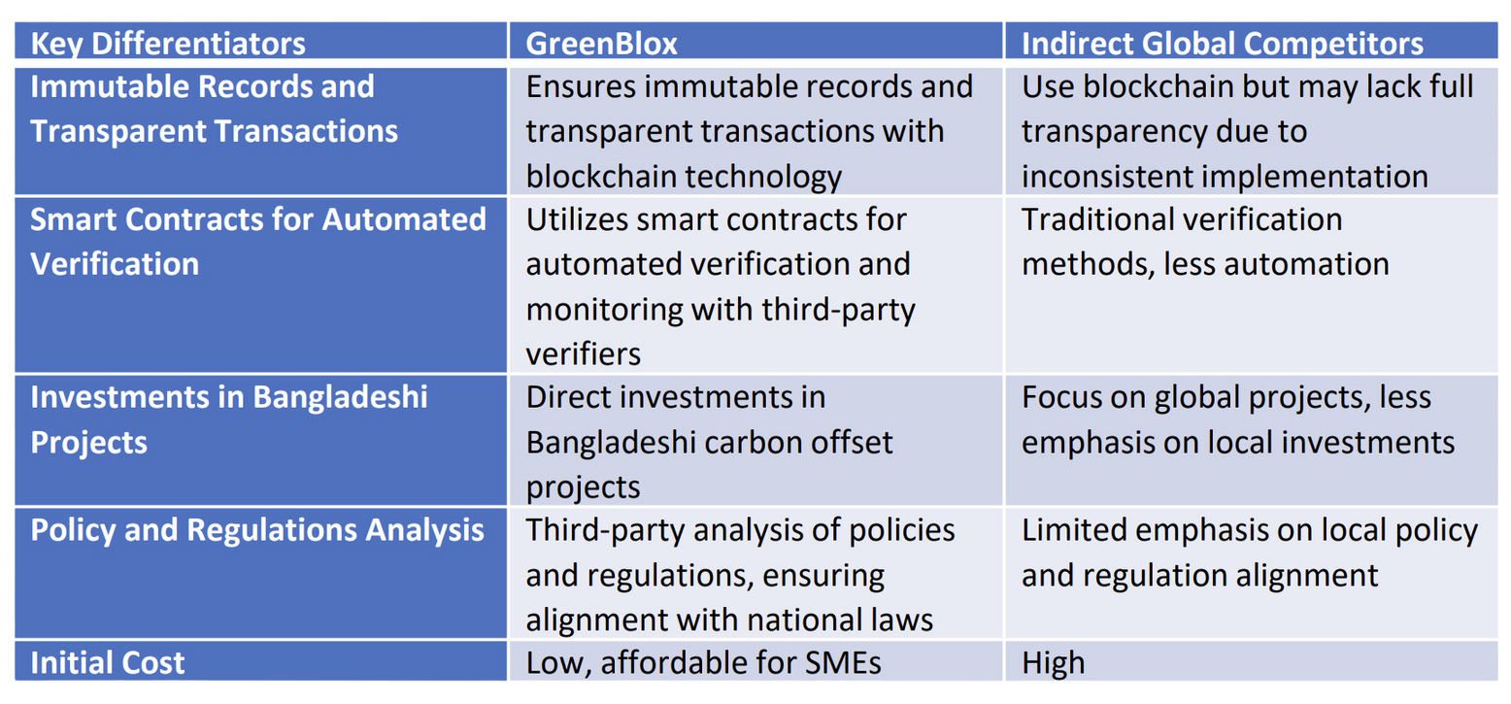
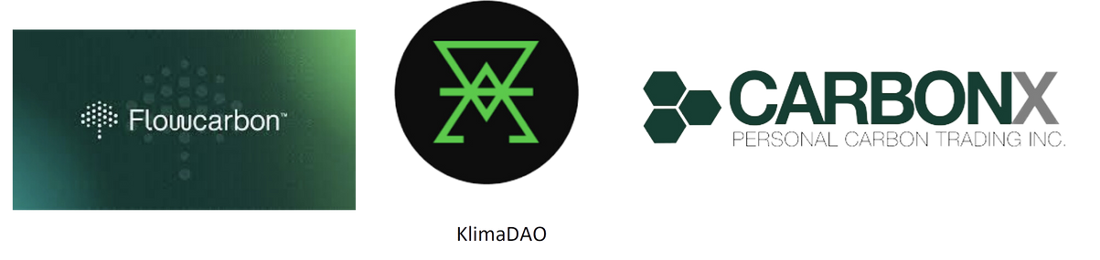
Comparative Analysis of GreenBlox
Indirect Competitors

Slide 11


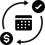
Business Model
Revenue Stream
Carbon Credit Sales
Transaction Fees
Selling tokenized carbon credits on the GreenBlox marketplace to mills and individuals looking to offset their carbon footprints.
Charging a percentage fee on each transaction that takes place on the platform.
Subscription Plans
Offering subscription plans for project developers and investors for premium services.

Slide 12

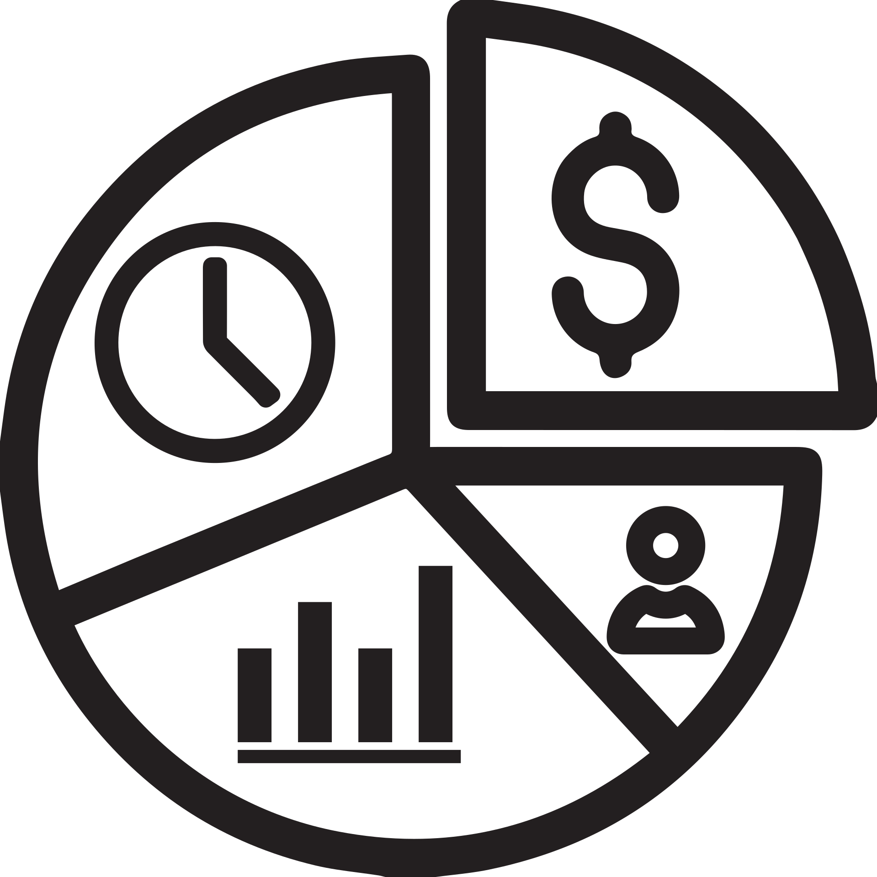
Business Model
Revenue Stream
DECENTRALIZED FINANCE (DEFI)
TOKEN-BASED ECONOMIES
Lending and Borrowing Platforms: Setting up DeFi platforms for lending and borrowing, earning through interest rates or transaction fees.
Initial Coin Offerings (ICOs): Raising funds through ICOs or similar token sales for blockchain-based projects.
Yield Farming: Offering services in yield farming or staking, where users earn rewards for providing liquidity or staking tokens.
Utility Tokens: Offering tokens that grant access to a specific service or product, creating revenue through token sales.
FINANCIAL INCLUSION AND MICROFINANCE
Lending and Microfinance Platforms: Offering peer-to-peer lending or microfinance solutions with blockchain, earning through interest rates or platform fees.
Tokenization Services: Facilitating the tokenization of assets (e.g., land, commodities) and earning through transaction or issuance fees.

Slide 13



Distribution Strategy
Market Entry
PR & Media Outreach
Local Partnerships
Press Releases
Local Community Engagement
Regularly distribute press releases announcing new projects, partnerships, or technological advancements. Target local media outlets, tech blogs, and business magazines.
Collaborate with local government bodies, NGOs, and environmental organizations in Bangladesh to establish credibility and facilitate adoption.
Meetups & Hackathons
Industry Events
Organize blockchain meetups and hackathons to build a community of developers, entrepreneurs, and enthusiasts.
Participate in or sponsor tech events, expos, and conferences in Bangladesh. This will increase visibility and provide networking opportunities with industry leaders and potential clients.
Support Local Startups
Case Studies & Testimonials
Invest in or mentor blockchain-based startups in Bangladesh, fostering innovation and creating success stories that resonate with the local market.
Pilot Projects
Publish success stories and testimonials from local businesses or sectors that have benefitted from blockchain technology.
Launch pilot projects with key stakeholders to demonstrate the platform's effectiveness and gather testimonials.

Slide 14



Distribution Strategy
Marketing Channels
Digital Marketing
Industry Events
Webinars and Workshops
Use social media, content marketing, and search engine optimization (SEO) to raise awareness and attract users to the platform.
Participate in environmental and blockchain conferences and trade shows to network and promote GreenBlox.
Conduct online webinars and workshops to educate potential users and partners about the benefits of using GreenBlox for carbon offsetting.

Slide 15



Distribution Strategy
Scaling Strategy
Geographic Expansion
Platform Enhancements
Strategic Alliances
Gradually expand to other countries in South Asia and beyond, replicating the successful model from Bangladesh.
Continuously improve the platform's features and user experience based on feedback and technological advancements.
Forge alliances with global environmental organizations and tech companies to enhance reach and capabilities.

Slide 16






Monitoring and evaluation (M&E)
Data Collection and Monitoring
Stakeholder Involvement
Risk Management
Continuous Data Collection
Identify Risks
Engage Stakeholders
Technology Integration
Mitigation Plans
Feedback Loops
Regular Monitoring
Reporting and Communication
Learning and Adaptation
Impact Assessment
Regular Reports
Continuous Improvement
Long-Term Impact
Transparent Communication
Knowledge Sharing
Sustainability

Slide 17
Impact of Carbon Offsetting on Climate Change
01
Emission Reductions
04
Carbon Tax
02
Achieving Net Zero
05
Financial Impact
03
Global Contribution
06
Sustainable project Funding Opportunity

Slide 18

How Blockchain-Based GreenBlox Works
User registers on GreenBlox platform
Hashed identifier recorded on blockchain
User browses available carbon offset projects
Selects a project to support
Project details uploaded
Smart contracts validate and monitor project compliance with third party and AI model integration
Automated updates via smart contracts
Continuous monitoring of projects
Transaction details recorded on blockchain
User purchases carbon credits

Slide 19
Architecture
Blockchain Platform Choice
CELO
Off-Chain Oracle Network
Celo's eco-friendliness, cost-effectiveness, and speed make it an ideal choice for our platform's success.
This network continuously updates and maintains the dynamic information of project developers, auditors, and investors in our database.
Auditors and Project Developers
Hardhat
Auditors assess the carbon offset projects submitted by developers. The results of these assessments are recorded on the blockchain, ensuring transparency and immutability.
Hardhat bridges our off-chain oracle network and the blockchain.
Investors and Project Developers
Auditors and Investors
Investment transactions and fund disbursements are recorded on the blockchain to maintain trust and ensure that funds are used as intended.
Auditors provide periodic updates on project performance to investors.

Slide 20
Solution
Roles in GreenBlox
2. Investors
Invest in carbon offset projects and purchase carbon credits
OVERVIEW OF INVESTORS
3. Regulators
Oversee compliance and regulatory standards
Heavy Industry and Manufacturing
Wood and Furniture: Wood Processing Mills
Pulp, Paper, and Wood Products: Paper Mills
Electronics and Electrical Equipment: Electronics Manufacturing Plants
4. Auditors (Third-Party Verifiers)
Conduct independent audits of carbon offset projects
Metal Processing: Non-Ferrous Metal Smelting Plants
Refining and Processing: Biomass Power Plants

Slide 21
Potential Challenges and Our Tactical Approach
KEY CHALLENGES OF GREENBLOX
Limited Awareness and Understanding
Regulatory Uncertainty
Integration with Existing Systems
Challenge
Challenge
Challenge
General lack of knowledge about carbon offsetting and blockchain benefits.
Underdeveloped regulatory framework for blockchain technology in Bangladesh.
Difficulty in integrating blockchain with current carbon credit and offsetting systems.
Tactical Approach
Tactical Approach
Tactical Approach
Conduct awareness campaigns and educational programs.
Partner with environmental organizations and institutions to disseminate information.
Engage with policymakers to advocate for supportive regulations.
Collaborate with regulatory bodies to help shape the framework.
Develop interoperability standards for seamless integration.
Provide technical support and resources for system integration.

Slide 22







Solution
ROLES IN GREENBLOX
1. Project Developers
Create and manage carbon offset projects
2 - Enhanced Verification and Monitoring
OVERVIEW OF PROJECT DEVELOPERS
4 - Market Stability and Price Assurance
Renewable Energy Project
Promotion of solar power
Solar irrigation
Waste-to-energy projects
Forestry and Land Use Projects
1 - Immutable Records and Transparent Transactions
3 - Real-time Data and Reporting
5 - Proper Funding for Sustainable Projects
Waste Management Projects
Sustainable Agricultural Practices
Carbon Capture and Storage (CCS) Projects

Slide 23

AI Integration
Report Summary Tool
Summarizes documents and compliance reports.
Carbon Footprint Calculator
Calculates carbon emissions.
ML-Based Prediction
XGBoost model predicts carbon reduction with 93% accuracy
Chat bot
Provides eco-friendly recommendations

